Slide 1
FeatureCAM 2007
Product Line

Slide 2
Note to Presenter
(This is a hidden slide)
This master copy of this presentation comes from our readily available FeatureCAM training materials.
You can download the most current version from http://distrib.featurecam.com.
If you have suggestions for enhancement to this presentation, please send them to support@featurecam.com, and please give the name of the PPT.

Slide 3
Agenda
This presentation is an overview of FeatureCAM’s product line in order to help you prepare to sell it

Slide 4
Product summary
Modern, easy-to-use use interface
Feature-based automation of low level details
Industry-leading feature recognition
Integrated
Broad product line with consistent user interface and automation
Milling and turning from solid models easily and quickly
Poised to dominate market

Slide 5
Why is It So Easy to Use?
Feature-based
Automated details
Integrated

Slide 6
Integration with Delcam Products
No plans for merging product lines
3-axis milling shared with PowerMILL
Plans exist for making the products exchange data, share additional technology (tooling, 5-axis simultaneous)
Sales Partners should concentrate on new customers that you have not been able to attract to PowerMILL or customers without integration expectations

Slide 7
Base Products
Stand alone products
  FeatureMILL
  FeatureMILL3D
  FeatureTURN
  FeatureTURN/MILL
  FeatureWIRE

Slide 8
Add-on Products
FeatureRECOGNITION
Solid Modeling
5-axis positioning
Tombstone
Native Import Modules (Catia V4, Catia V5, Pro/E, UG, STEP)
Machine Simulation
Advanced Turn/Mill
Network Database
Network Licensing

Slide 9
FeatureCAM Product Line
All products are in a single executable program
All programs receive one major upgrade each year (July), and multiple point release throughout year
Interface is consistent across all products

Slide 10
Common Functionality

Slide 11
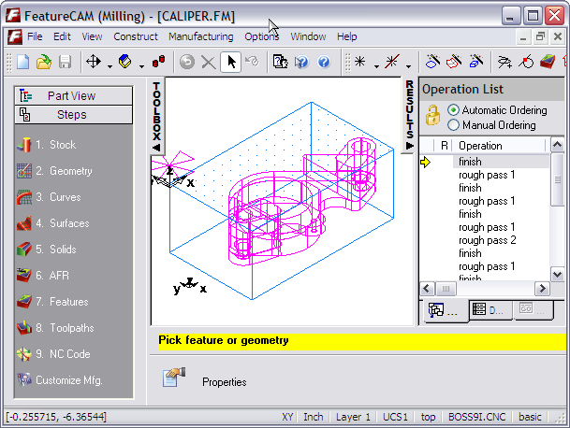
Manufacturing Results Window
Graphics Window
Steps
Message Line
Simple access to most program functions
Documentation: Tool lists, NC program, Operations List
Geometry, toolpaths, all simulations

Slide 12
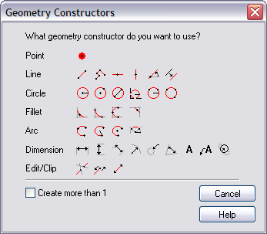
Common Functions
2D Drawing
Curve Creation
Viewing
Simulation
Tooling database
Material database

Slide 13
Common Functions
2D Drawing
  Lines
  Circles
  Fillets
  Dimensions
  Editing

Slide 14
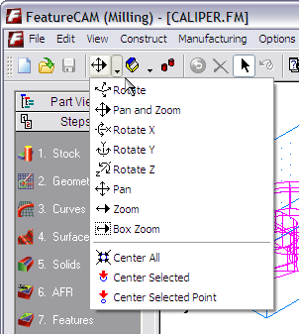
Common Functions
Viewing
Shading
Screen management

Slide 15
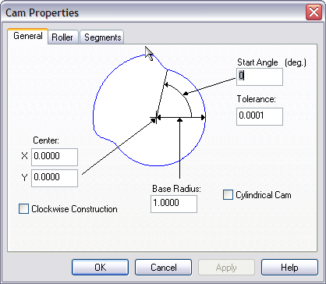
Common Functions
Curve Creation
  Chaining of lines and arcs
  Curve Wizard
    From Curves
    From Surfaces
    Special curves like cams and gears

Slide 16
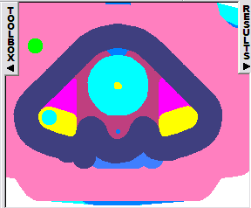
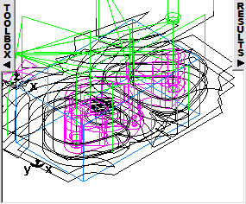
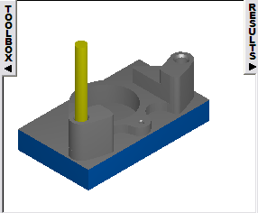
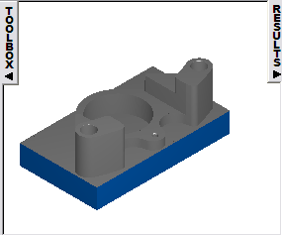
Common Functions
Simulation
  2D centerline
  2D area
  3D shaded
  3D rapid cut
  3D Machine Simulation
Notes:
Rapid cut is for tool/die

Slide 17
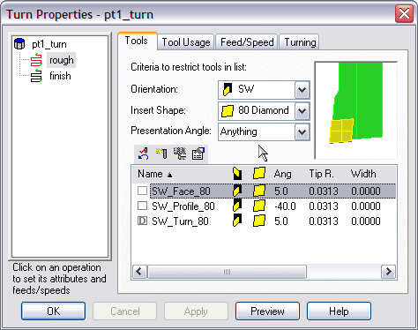
Common Functions
Tooling databases
Material databases

Slide 18
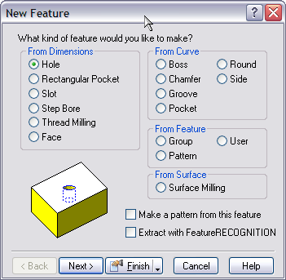
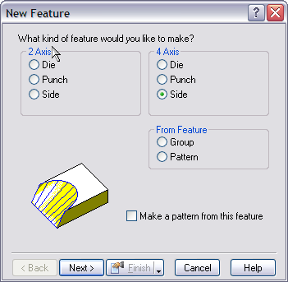
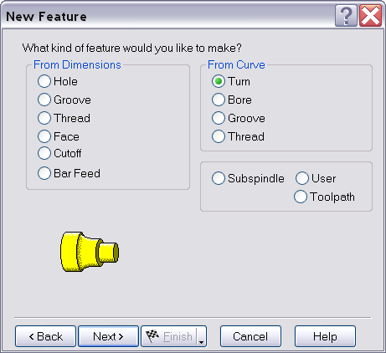
Feature Sets are Different
Milling
Wire
Turning

Slide 19
Individual Products

Slide 20
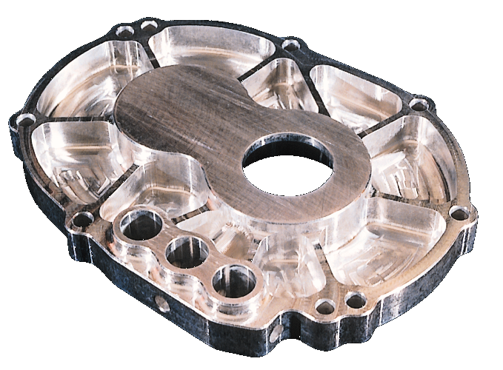
FeatureMILL
Premier 2 ½ D milling
  Integrated convenient drawing tools
  Creates toolpaths from dimensions
  Built-in manufacturing knowledge
First feature-based CAM product
FeatureCAM core product

Slide 21
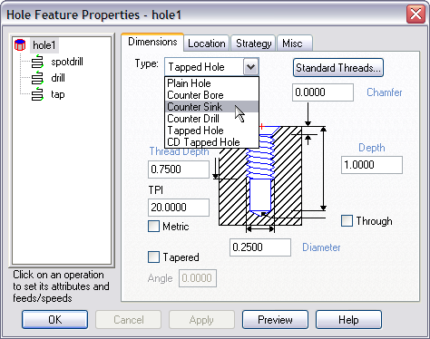
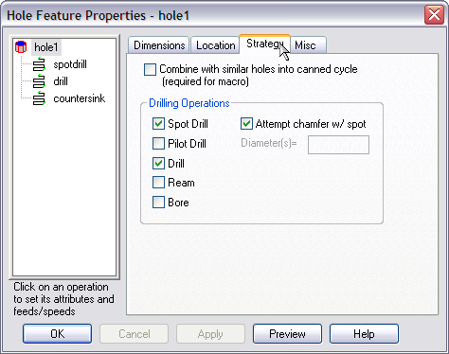
FeatureMILL Holes
Single feature can create up to 7 operations
Simple access to strategies
Variety of tooling options
Strong area in FeatureMILL

Slide 22
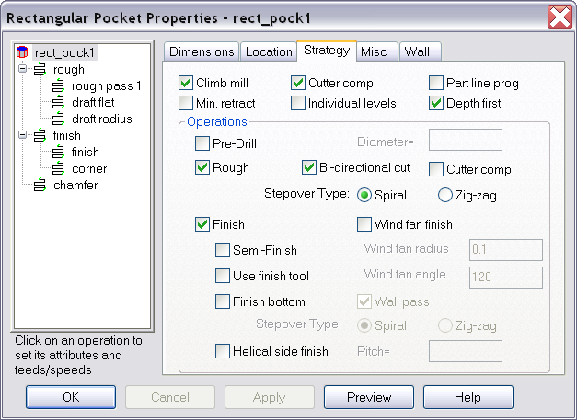
FeatureMILL Milling
Pocket, Boss, Side
Multiple islands, variable height
Bottom radii
Drafted
Wall curves
Cutter compensation

Slide 23
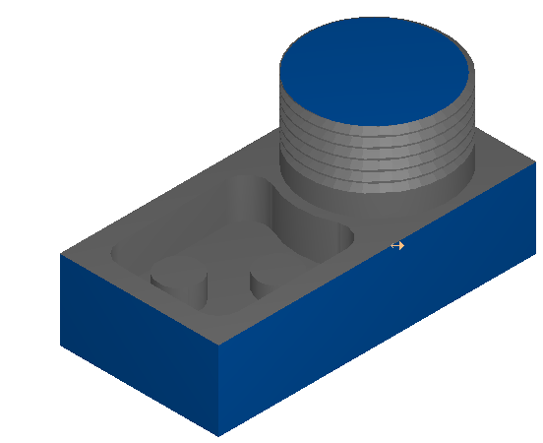
FeatureMILL Additional Milling
Thread milling
Grooves
Step bores
Face milling
Basic engraving

Slide 24

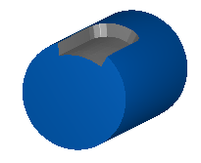
FeatureMILL 4-axis
Multiple setups allowed for a single part
Wrapping
  Transforming one axis into a rotation
Indexing
  Around any axis

Slide 25
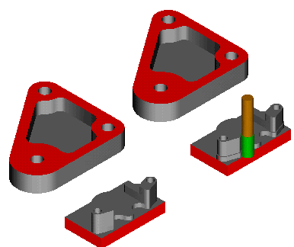
Multiple Part Document
Simple interface for machining multiple parts in vises
Can mix parts
Can be separate parts or a single sheet
Precursor to Tombstone module

Slide 26
FeatureMILL
Strengths
  Fastest toolpath generation in the CAM market
  Concise control of a variety of techniques
  Automation
  Complete feature set
Weaknesses
  Drafted feature code cumbersome
  Bundling operations into features is sometimes foreign to some users

Slide 27
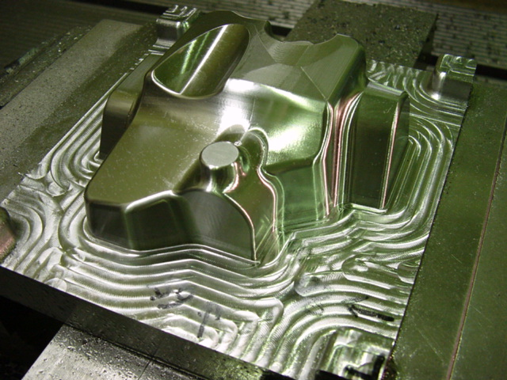
FeatureMILL3D
3D surface/solid/STL import
3D surface modeling
Variety of 3D multi-surface roughing and finishing techniques

Slide 28
Appeal of FeatureMILL3D
55% of all FeatureCAM revenues world-wide (over 60% in Asia)
Integrated within the FeatureCAM interface
Excellent product for 3D prototypes and less complicated molds and dies

Slide 29
FeatureMILL3D Components
Includes FeatureMILL & FeatureRECOGNITION
3D surface modeling
3D surface machining
FeatureMILL3D
FeatureRECOGNITION
FeatureMILL

Slide 30
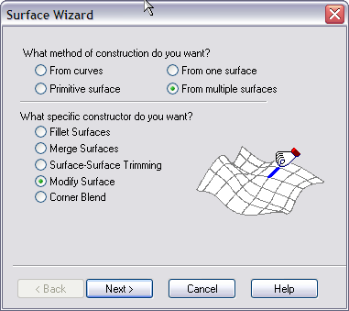
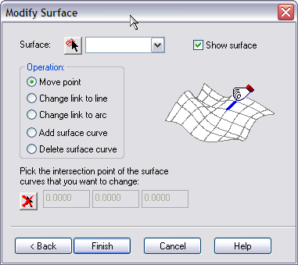
3D Surface Wizard
Convenient interface to surface modeling
Primarily used for creation of auxiliary surfaces or to repair models
Two step wizard for
  From curves
  Primitive surfaces
  From one surface
  From multiple surfaces

Slide 31
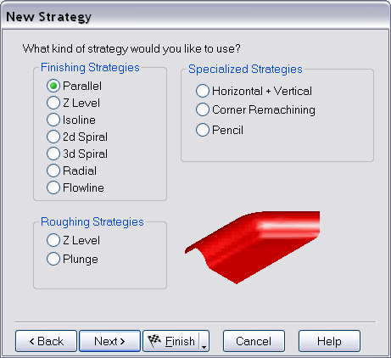
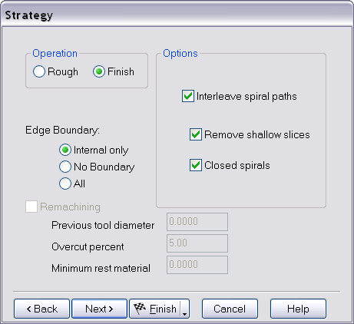
3D Surface Milling
Presented in a wizard interface
Only top level attributes displayed
Features can create multiple operations

Slide 32
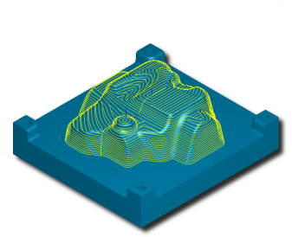
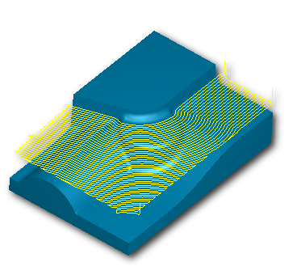
3D Techniques
Subset of Delcam techniques
Less reliance on toolpath editing
Lead and ramp modifications are made in the feature itself

Slide 33
FeatureMILL3D
Strengths
  Well integrated into product line
  Affordable 3D
  Competes strongly with other broad CAM products
Weaknesses
  Automated approach
  Interactive approach can make large models (>200 megabytes) slower

Slide 34
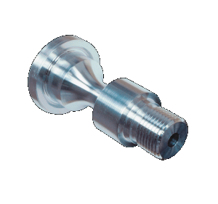
FeatureTURN
Basic 2-axis turning module
Features include
  OD Turning
  ID Boring
  Grooves
  Threads
  Cutoff
  Facing
Supports subspindle, part catchers, bar pullers

Slide 35
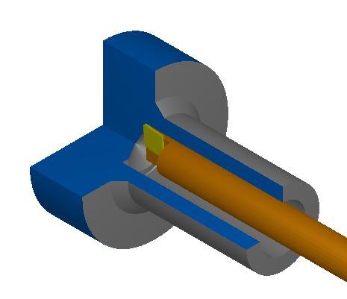
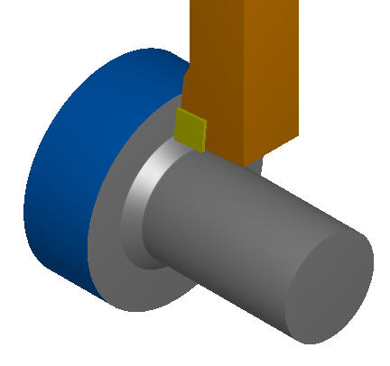
FeatureTURN - OD/ID Turning
Multiple strategies for roughing and finishing
Control over entry and exit
Cutter compensation

Slide 36
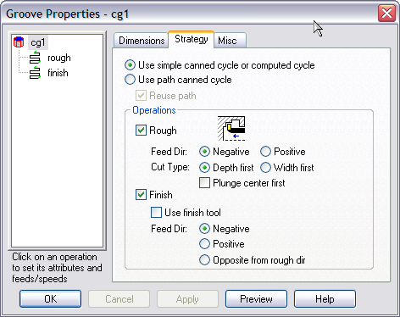
FeatureTURN - Grooving
OD or ID
Specified from dimensions or from a curve
Depth-first or width-first
Cutgrip tooling support

Slide 37
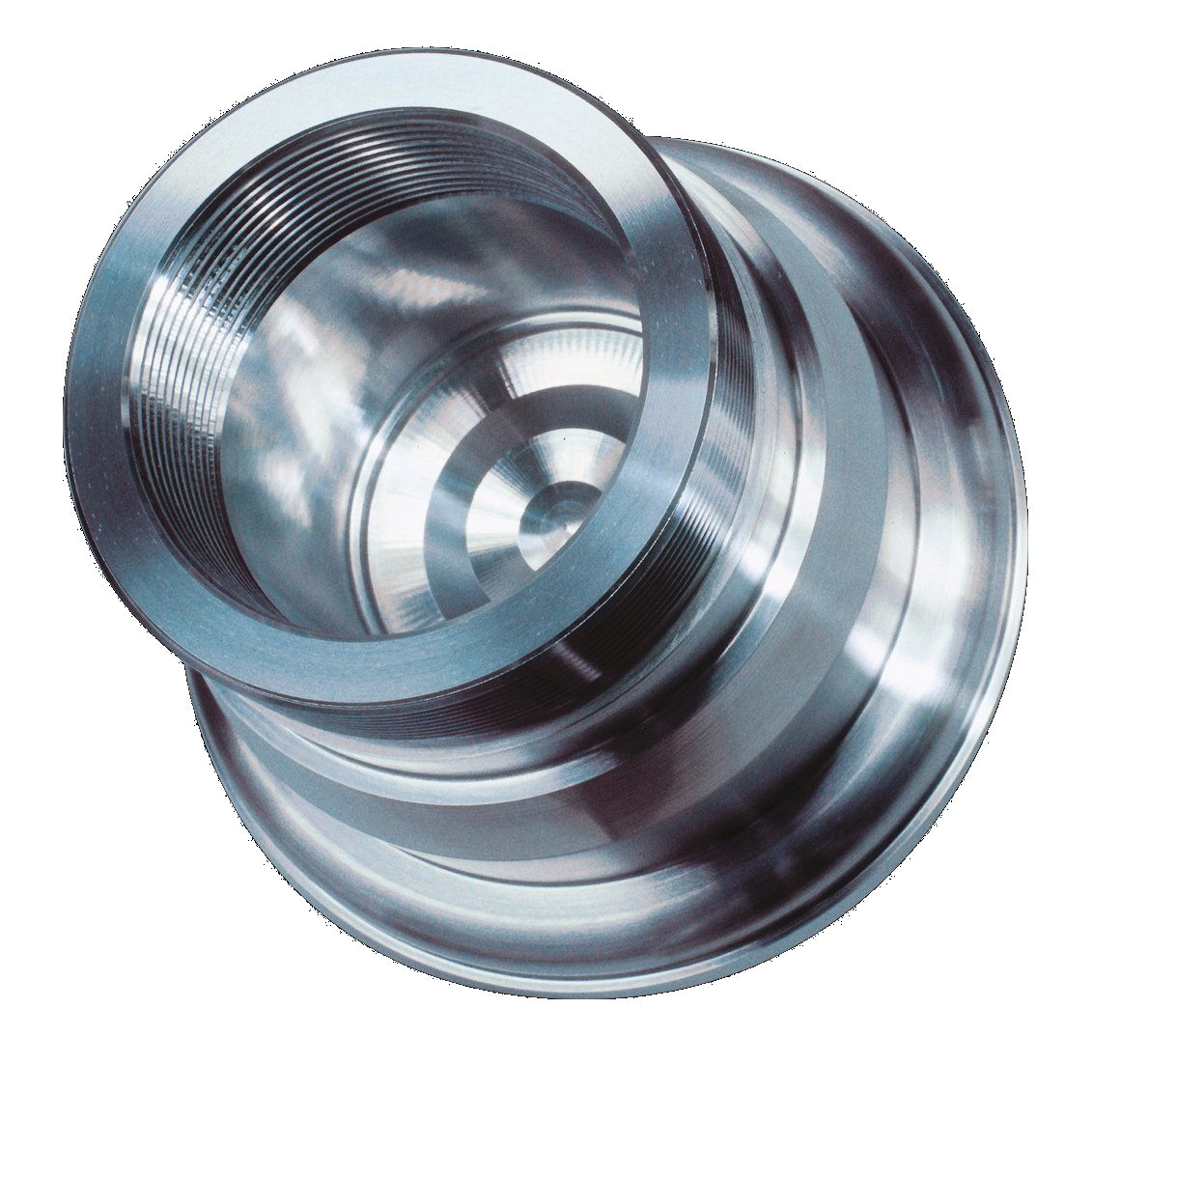
FeatureTURN - General
Strong Fanuc canned cycle support
  OD/ID Turning
  Grooving
  Threading
  Holes
Thorough tooling library
Tooling-specific toolpaths

Slide 38
FeatureTURN
Strengths
  Fast generation of toolpaths
  Tight integration with tooling library
  Strong Fanuc support
Weaknesses
  Not as automated as FeatureMILL
  Strong competition from on-line programming

Slide 39
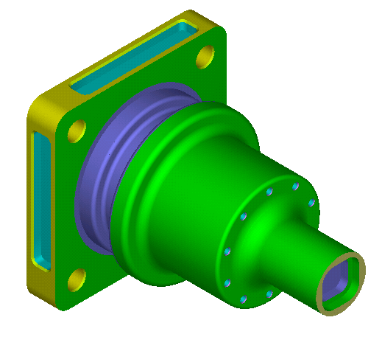
FeatureTURN/MILL
Supports C and Y axis lathes
Supports rotary (live) tools
User positions features and FeatureTURN/MILL calculates rotations
Supports Mori-Seiki, Okuma, Hardinge, Mazak, Haas

Slide 40
FeatureTURN/MILL Components
Includes FeatureMILL & FeatureTURN
Allows the posting of both types of features into a single NC program
FeatureTURN/MILL
FeatureTURN
FeatureMILL

Slide 41
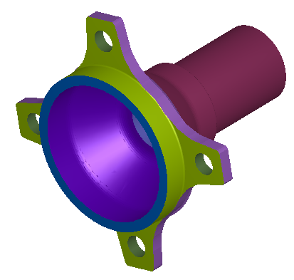
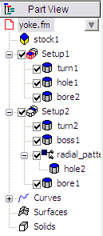
Turn/Mill Benefits
Convenient to mix milling and turning features
Multiple part setups are a part of every FeatureCAM product
Ease of creation of radial patterns

Slide 42
FeatureTURN/MILL
Strengths
  Easy to mix turning and milling features
  Fits into FeatureCAM interface
  Multiple setups can be simulated together
  Consistent interface
Weaknesses
  Post processors are more difficult to create
  Patterns of curved features can be difficult to position

Slide 43
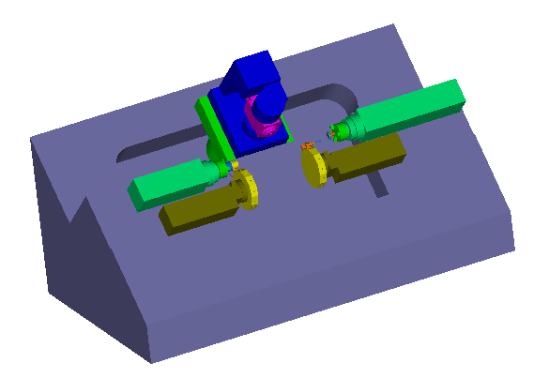
Advanced TURNMILL

Slide 44
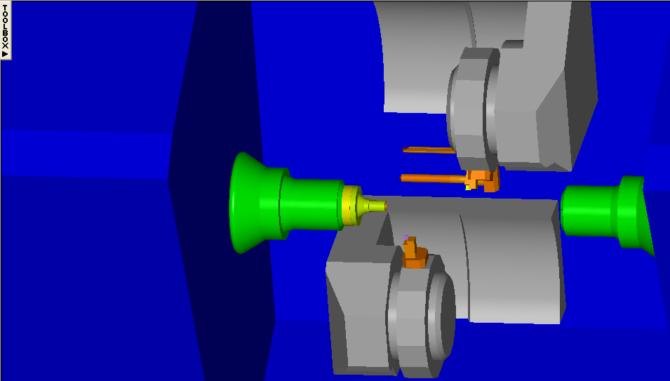
Advanced TURNMILL
Add-on to FeatureTURN or FeatureTURN/MILL
Coordinates movement of up to 4 turrets
Turn/Mill allows the additional coordination of a B-axis milling head

Slide 45
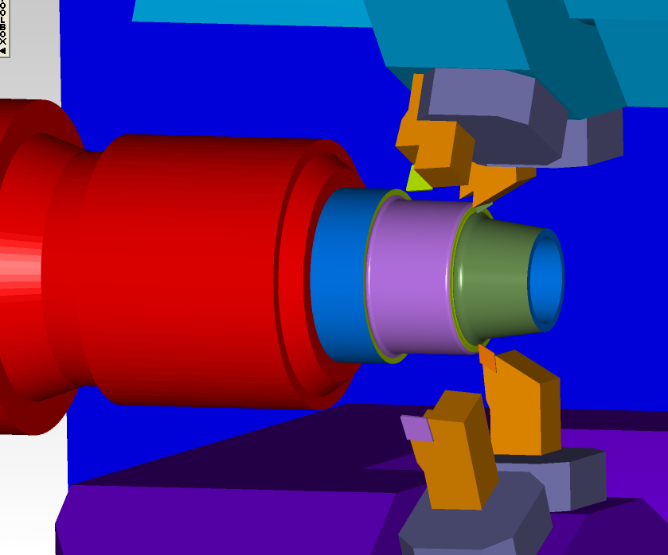
Advanced TURNMILL
Synchronization of multiple turrets
Some OD features automatically schedule multiple turrets

Slide 46
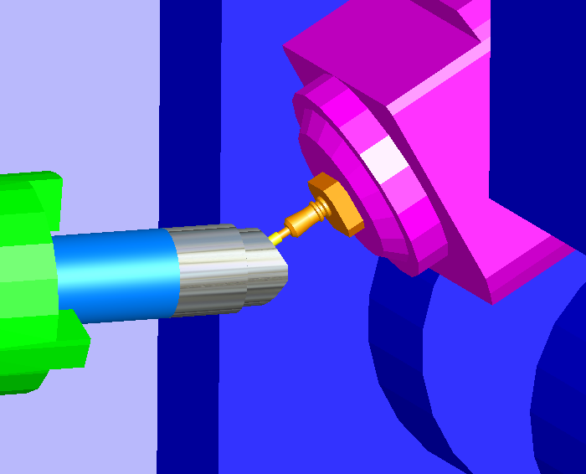
Advanced TURNMILL
B-axis support
Common applications
  tool holders
  oil drilling tools
  complex valves
  gear products
  more…

Slide 47
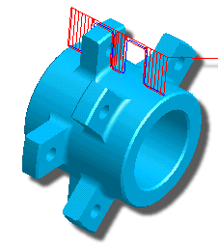
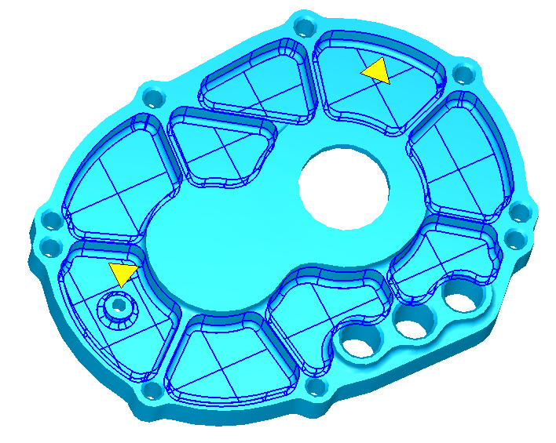
FeatureRECOGNITION
Feature recognition from solid or surface models
Automatic and interactive recognition (AFR & IFR)
Turning, milling and wire
Excellent CAM product for mid-range MCAD users

Slide 48
Recognition Methods
AFR
  Global method
  Based on horizontal slicing
  Works well for entire part programming
  May create unusual features
  Requires a solid
Automatic by feature type
  More localized
  Based on vertical surfaces
  Better features are often created
  Less automated

Slide 49
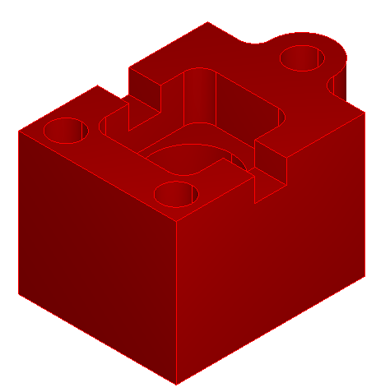
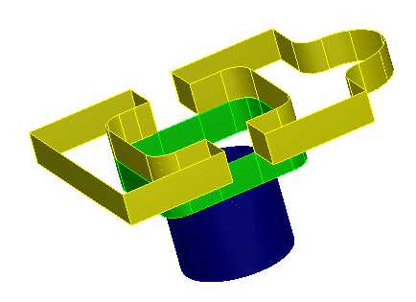
AFR

Slide 50
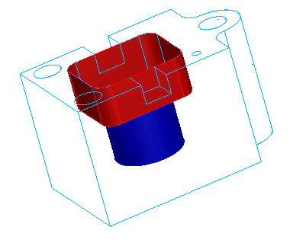
Automatic by Feature Type

Slide 51
Interactive Recognition (IFR)
Provides more control over the process, but takes more of the user’s time
Works on surface and solid models
Operates on surfaces or curves that are extracted from the model

Slide 52
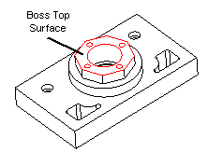
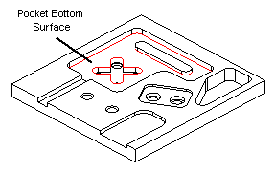
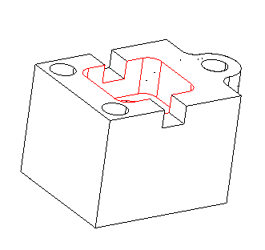
IFR from Surfaces

Slide 53
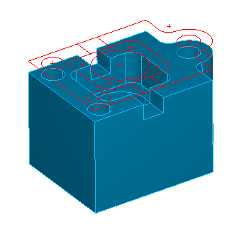
IFR From Curves
Curves are projected from vertical surfaces
Most powerful recognition method
Only way to recognize drafted features
Requires the most interaction

Slide 54
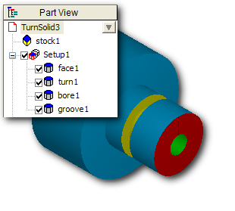
Turning Recognition
Extracts profile curves from solid
Curve-based techniques fairly powerful

Slide 55
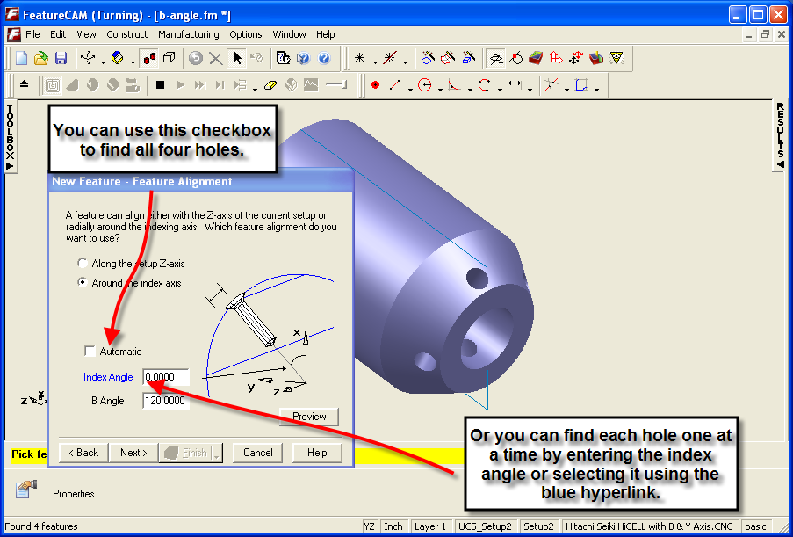
Advanced TURN/MILL B-axis Recognition
B-axis FR on turnmill parts
Same easy to use interface as our milling FR
Notes:
BaxisSupport.fm

Slide 56
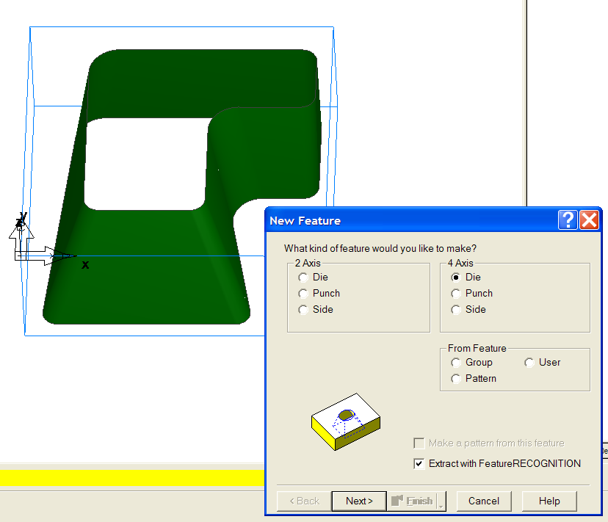

Wire EDM Feature Recognition
FeatureWIRE can create 4-axis feature from ruled surfaces
Notes:
wire4xIFR.fm

Slide 57
FeatureRECOGNITION
Strengths
  Big product differentiator
  Best in the business
  Many methods that can be used
Weaknesses
  Still a lot of work to do on this technology (industry still has no silver bullet)
  Requires experience to use the proper combination of tools

Slide 58

WireEDM
2-axis, 2-axis Taper, 4-axis
Very friendly interface
Part of broad solution
Good companion product at mold and production shops

Slide 59

Wire Details
Feature types are die, punch and side
Operations included for both attended and unattended operation
Good automatic and interactive curve matching tools

Slide 60
FeatureWIRE
Strengths
  Well integrated into user interface
  Nice solid simulation
  Features accelerate the process
  Many options for control
  Feature recognition
Weaknesses
  More details left to implement

Slide 61


Tombstone
Production milling on vertical or horizontal tombstones
Arrange a variety of parts and let FeatureCAM take care of the details
Simulates the Toolpath While Displaying the Tombstone, Parts, Tools, Tool Holders, Spindle and Rotating the Tombstone

Slide 62
Tombstone Steps
Create parts separately in FeatureMILL
Arrange parts on the tombstone
Adjust ordering options
Simulate and post code

Slide 63
Tombstone
Strengths
  Explicit support of these machines
  Can mix any number of parts
  Flexible definition of tombstone
Weaknesses
  Some customers want more ordering control

Slide 64


5-Axis Positioning
Minimizes fixturing of 2 ½ D parts
Generate NC Code with Respect to One Coordinate System or Use Individual Coordinate Systems for Each Face
Supports 5-face Machining

Slide 65
5-axis Positioning
Strengths
  Inexpensive 5-axis positioning module
  Supports a variety of machine definitions
  Machine simulation
Weaknesses

Slide 66

Solid Modeling
Integrated 3D Solid Modeling
Solid Manipulation
  Core/cavity separation
  Parting surface creation
  Manipulate multiple solids
Option for 2.5D or 3D

Slide 67
Solid Modeling
Strengths
  Integrated well into FeatureCAM
  Parasolids based
  Wizard interface is well received
Weaknesses
  Core/cavity tools weak
  Import is separately licensed

Slide 68

Network
Concurrent licensing via FlexLM (PAF)
Requires minimum of 3 seats
Quoted separately from the CAM seats
  3-5 computers
  5-10 computers
  > 10 computers

Slide 69
Application Programming Interface
Using Visual Basic, C++, or other external programming systems
Using the integrated SaxBasic
Comes with every seat of FeatureCAM
Non-programmers have discovered that they can write simple applications
Responsive development of new hooks

Slide 70
Programming Interface
The programming interface allows FeatureCAM to be automated, customized, and enhanced
Automated
Easier to use
Customized
Think like you think
Enhanced
Do new things!

Slide 71
Programming Interface
Some ideas for applications:
  Feature recognition using color
  Center stock about index axis
  Select surfaces of same height
  Alternate feed/speed tables (concept)
  Clamp avoidance
  Automatic tool selection based upon exposed length

Slide 72

Machine Simulation

Slide 73

Machine Simulation
Provides machine simulation and material removal
Separate module for annotating the machine movements
NOT compatible with Delcam machine definitions
Requires a solid model of the machine

Slide 74

Machine Simulation
Requires solid model of the machine
  Import or model
Available for all milling and turning applications
Nothing special for wire
Highly recommended for 2D milling, all turning, 5-axis positioning and 4-axis indexing and wrapping

Slide 75

Shared Database

Slide 76
Database Structure
Feed &
Speed
Database
Post
Processors
Tooling
Database

Slide 77
Conclusion
Easy-to-use
Integrated
Feature-based
Broad feature-based product line
Many new features for larger customers
Easily differentiated from the competition
Constantly prioritizing suggestions from customers and our channel for product improvements

